Slide 1


Sprocket Central Pty Ltd
Data analytics approach
Lighthouse and Innovation Team,
Tony Smith (Engagement Manager)
Irivboje Young (Junior Consultant)

Slide 2
Agenda
Introduction
Data Exploration
Model Development
Interpretation

Slide 3

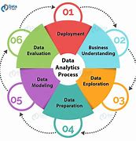
Introduction
Approaches to be taken in identifying the 1000 target customers for Sprocket Central Pty Ltd
As a result of the technicalities involved in your business and in-line with the company’s target of getting maximum profit, we would be involved in detailed data analysis of the datasets we received from you. This would help us in identifying the nature and characteristics of target customers needed for good sales and profitability.
Our approach would be based on three phases: Data Exploration; Model Development and Interpretation.

Slide 4

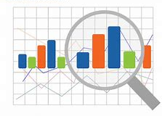
Data Exploration
Data Exploration
This is also known as Exploratory Data Analysis (EDA) and it would be carried out to help us understand the structure of the datasets, the distribution of the values and the relationships that exist among the values. Extra values/columns might be calculated, for example, age would be deducted from date of birth.
The datasets received from Sprocket Central would be explored using data visualization to create charts.

Slide 5

Model Development
Model Development
Here, we would be looking into any mathematical equations or relationships that can be used to predict results.
This involves relating the values from the datasets in predicting future outcomes. The visualization created through exploration would be used to predict future outcomes. For example; we would look at how age or location affects purchase, also job industry and wealth category of customers.

Slide 6
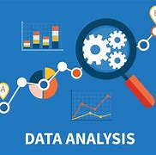
Interpretation
Interpretation
The developed model would then be interpreted to provide information on the expected characteristics of target customers which would help Sprocket Central Pty Ltd to make maximum profit.
The interpretation of the result would then lead to its presentation or reporting for clarification purpose.

Slide 7
Thank you for the attention

